Slide 1

12/11/2024
Machine Learning II
SENTIMENT ANALYSIS with TRANSFORMERS for JOB SATISFACTION Arturo Max Pagan
Image Source

Slide 2
PRESENTATION AGENDA
PRESENTATION AGENDA
MACHINE LEARNING II
Introduction
Previous Methods
How Transformers Work
Walk Through Example
Conclusion
1
2
3
4
5

Slide 3

SENTIMENT ANALYSIS
MACHINE LEARNING II
Why Sentiment Analysis?
Image Source
Important to understand underlying emotions
Likely too time-consuming to do it by hand
Waste of time, or technology should do it for you
Enter Sentiment Analysis!

Slide 4

TRANSFORMER MODELS
MACHINE LEARNING II
Why Transformer Models?
Image Source
Introduced in 2017 - “Attention Is All You Need”
Type of Neural Network
Specializes in understanding words in context
Foundation of current AI/LLM Boom
Famous examples include GPT, LLama, Claude
Could be a great means of sentiment analysis!

Slide 5
PREVIOUS METHODS
MACHINE LEARNING II
Bag-of-Words and Naive-Bayes
“I Love My Job But Dislike The Hours”
I Love My Job But Dislike The Hours
🫳 👍 🫳 🫳 👎 👎 🫳 👎
40% 80% 40% 40% 55% 60% 40% 40%
👍 🫳 👎
30% 40% 30%
Each word without context
“Good” - positive
“Not Good” - also positive?

Slide 6

PREVIOUS METHODS
MACHINE LEARNING II
Lexicon & VADER
Image Source
Valence Aware Dictionary and sEntiment Reasoner
Pre-built dictionary of words
Sentiment score given by humans
Human derived formulas create patterns like:
Understands punctuation: “great!” vs. “great.”
Understands negative polarity: “not good” is the opposite of “good”
Might not be ideal for highly specialized data

Slide 7
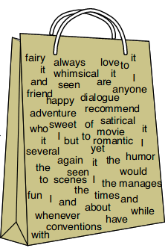
PREVIOUS METHODS
MACHINE LEARNING II
Things to Learn: Bag-of-Words and Naive-Bayes
Image Source
This method teaches us a lot - particularly tokenization
It is important to break up the text into smaller chunks, like words
Give the text numerical meanings for the machine too interpret
However, the lack of context might make it too simplistic

Slide 8

PREVIOUS METHODS
MACHINE LEARNING II
Things to Learn: Lexicon & VADER
Image Source
Not machine learning - human-developed
Uses mathematics to understand words in context
Uses a pre-built lexicon as a sort of ‘skeleton’
has an understanding of words before we even begin to use it

Slide 9
PREVIOUS METHODS
MACHINE LEARNING II
Recap: Requirements of Good Sentiment Analysis
Puzzle pieces for strong sentiment analysis:
Break up passages into smaller chunks
Take the smaller chunks and use numbers to represent some form of meaning
Learn from words by themselves
Learn from words in their context
Transformer LLMs might be a good candidate!
But how do they work?

Slide 10
TRANSFORMERS
MACHINE LEARNING II
Enter the Transformer! (LLM)
Neural Networks with lots of matrix-vector multiplication.
Matrices parameters/weights (from training)
Vectors data (information it is presented with)
Words are stored numerically, like BoW, but in a much more complicated way - as vectors!
Word ‘meanings’ are represented by directions in a vector space
word
meaning

Slide 11
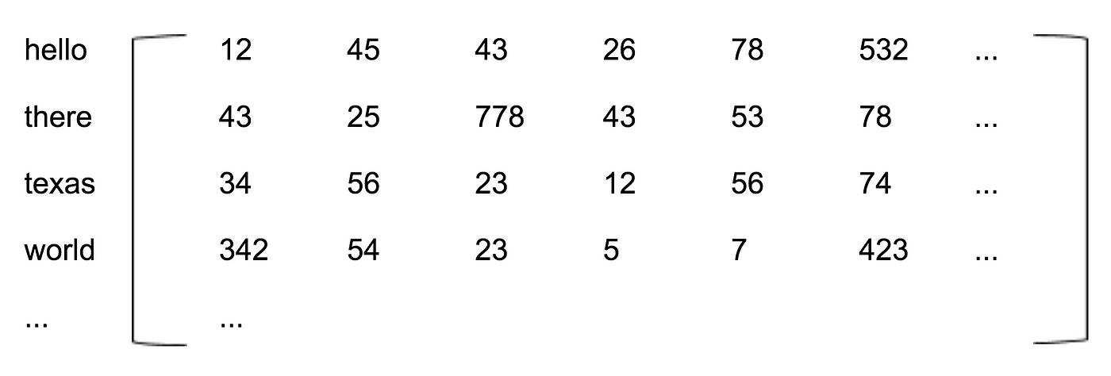
TRANSFORMERS
MACHINE LEARNING II
Understanding the Embedding Matrix
Image Source
Each word has its own vector pointing in its own direction.
Before the model is trained - these are random
As the model trains - similar words point in similar directions
These directions come to represent meaning
good
bad
job
work

Slide 12
TRANSFORMERS
MACHINE LEARNING II
Understanding the Embedding Matrix
Travel between words in vector-space!
🚀
positive
satisfied
negative
dissatisfied

Slide 13
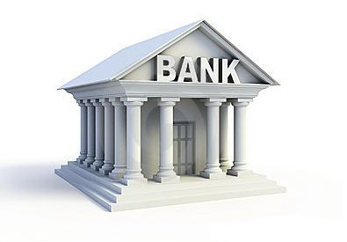

TRANSFORMERS
MACHINE LEARNING II
Understanding “Attention”
Image Source
Image Source
Still issues with words & context
Words can mean two different things - Bank
How do transformers deal with this? - context, like we do
Thanks to Attention

Slide 14

TRANSFORMERS
MACHINE LEARNING II
Understanding “Attention”
My Kind Manager - “Manager” vector changes in nice ‘direction’
My Evil Manager - “Manager” vector changes in a vitriolic ‘direction’

Slide 15
TRANSFORMERS
MACHINE LEARNING II
Understanding “Attention”
I Hate My Job And My Evil Manager
GPT PREDICTS:
“NEGATIVE”

Slide 16
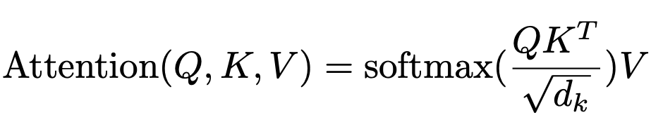
TRANSFORMERS
MACHINE LEARNING II
Understanding “Attention”
Image Source
Q, K, V - vectors associated with a word/token
Example - Q is for Query
Think of it like questions a word is asking for context

Slide 17
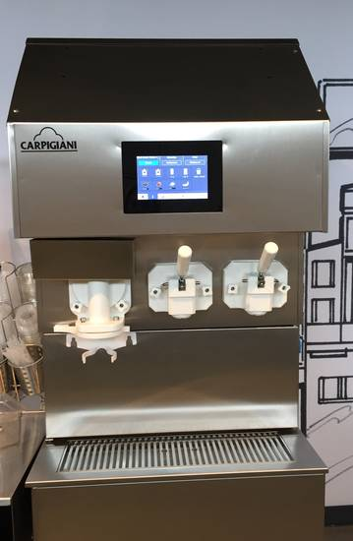
TRANSFORMERS
MACHINE LEARNING II
The Benefits of Fine-Tuning
Image Source
Give your transformer model a bit more context!
Mcdonalds & the dreaded Ice Cream Machine

Slide 18
TRANSFORMERS
MACHINE LEARNING II
The Benefits of Fine-Tuning
Review | Sentiment
Ice Cream Machine - you know the vibe | Negative
That Ice Cream Though | Negative
Transformer Model
More context!

Slide 19
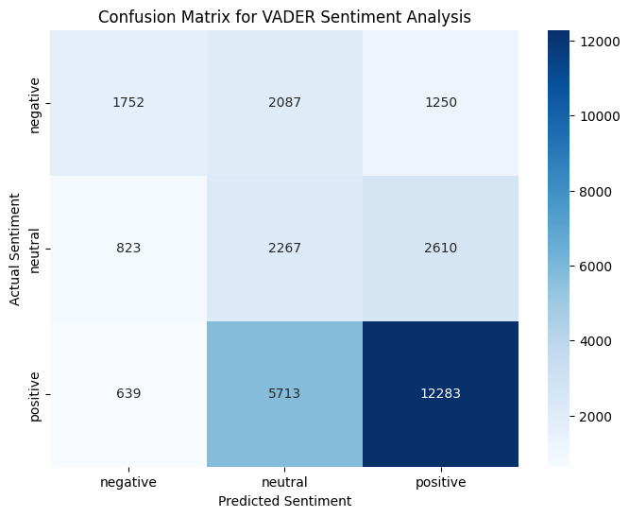
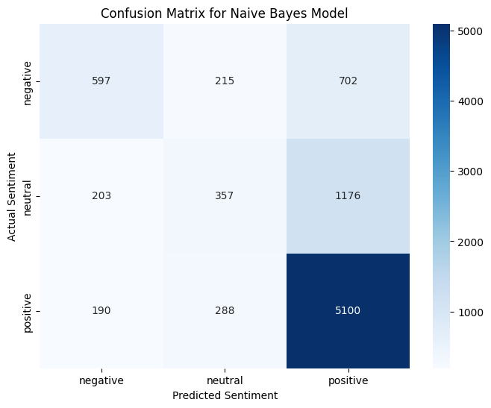
EXAMPLE CODE
MACHINE LEARNING II
Sentiment Analysis - Comparing Methods

Slide 20
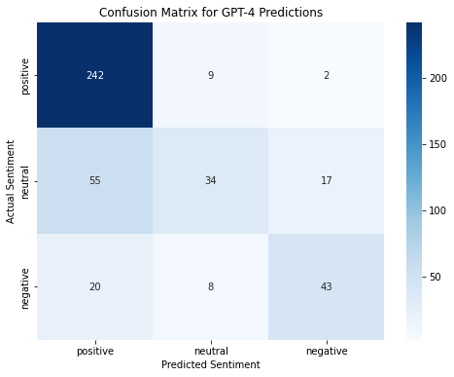
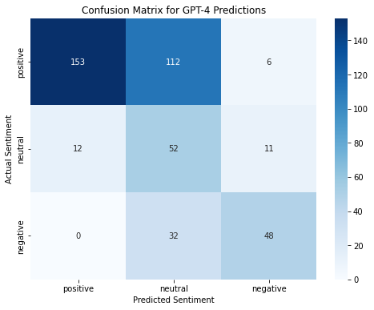
EXAMPLE CODE
MACHINE LEARNING II
Sentiment Analysis - Comparing Methods
Base GPT-4 Fine-tuned Model

Slide 21
CONCLUSION
MACHINE LEARNING II
Conclusion
Transformer models allow machines to understand words like never before.
Might not always be the perfect choice for sentiment analysis, but it can be a powerful tool in your toolbelt.
Can transform the way we work!

Slide 22
THANK YOU!
References:
https://www.tandfonline.com/doi/pdf/10.1080/19312458.2018.1455817?utm_source=chatgpt.com
https://ojs.aaai.org/index.php/ICWSM/article/view/14550?utm_source=chatgpt.com
https://journalofbigdata.springeropen.com/articles/10.1186/s40537-023-00861-x?utm_source=chatgpt.com
https://link.springer.com/article/10.1057/s41270-021-00109-8?utm_source=chatgpt.com
https://courses.washington.edu/ling575/SPR2014/slides/ling575_class2_features_short.pdf?utm_source=chatgpt.com
https://aclanthology.org/W16-1626.pdf?utm_source=chatgpt.com
https://youtu.be/wjZofJX0v4M?si=9KZuBFNXmMTn58bd
https://www.kaggle.com/datasets/davidgauthier/glassdoor-job-reviews?resource=download
https://www.kaggle.com/datasets/tusharcorbic/amazon-job-reviews-usa-india-20082020

Slide 23

GITHUB
REPO:
Link

